Slide 1

AI Journey: Past, Present and Your Future
Alper Ebicoglu
Co-Founder of Volosoft
twitter.com/alperebicoglu
Notes:
AI is transforming the way we build software. Every day, a new AI tool comes up! for many developers, the journey from zero to AI can feel overwhelming. And sometimes you feel you are behind this technology. In this talk, we’ll explore the evolution of AI—from its early days to the cutting-edge advancements shaping the future. We’ll learn how any developer can start integrating AI into real-world projects. As a simple developer, we will write the simplest AI application live in C# in a short time. It's developers' turn to talk about AI. Join me to understand its potential and start taking your first steps toward building AI-powered apps tomorrow🚀

Slide 2
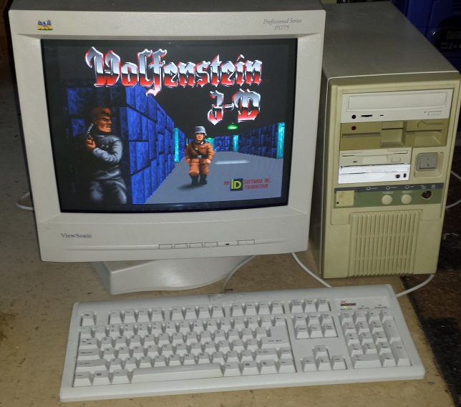
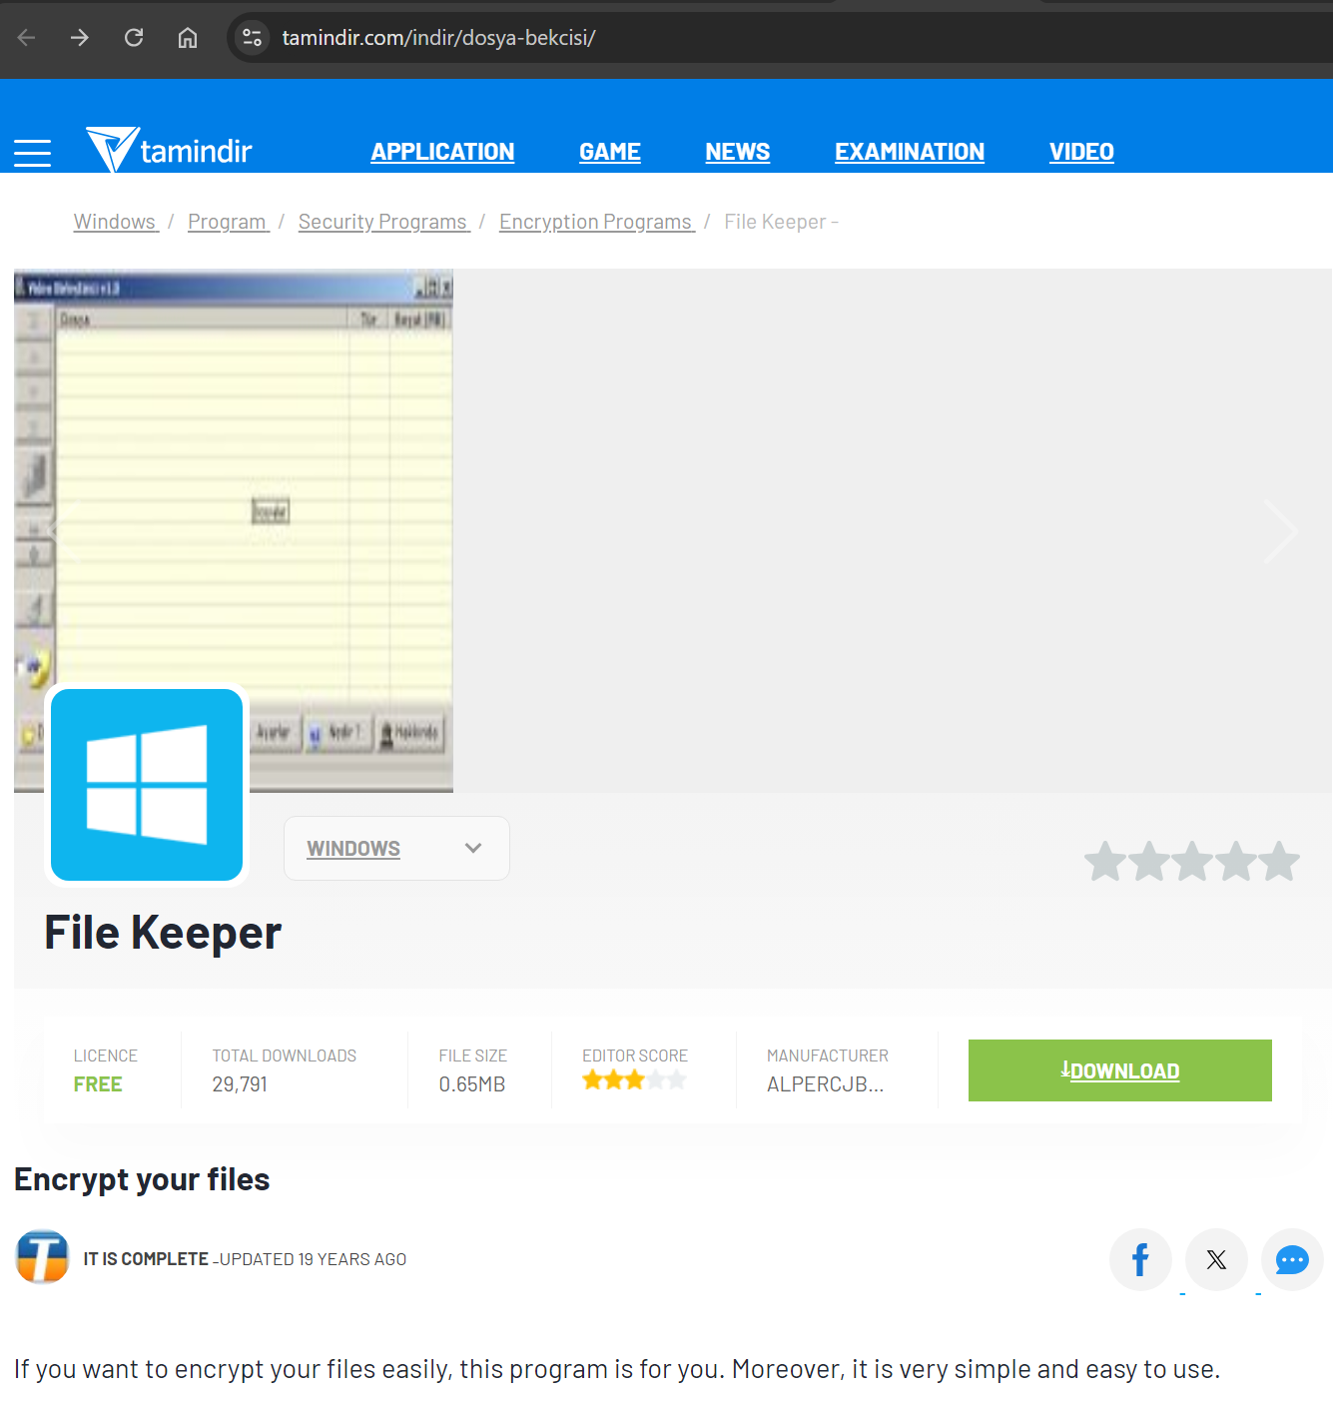
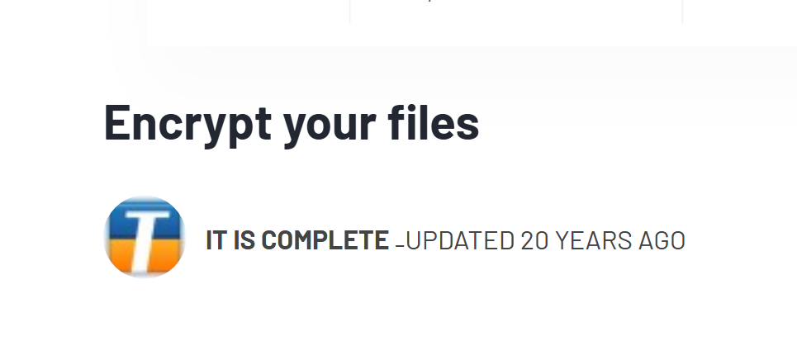
1997 — Started with Intel i386 processor and Q-Basic
2004 — First App on .NET Framework 1.0
2006 — Software Engineering
2010 — Master degree on MBA
2017 — Co-Founder of Volosoft

Slide 3

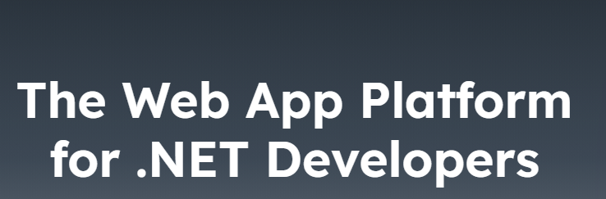
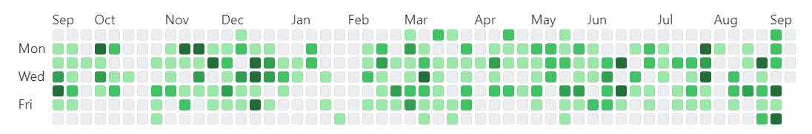

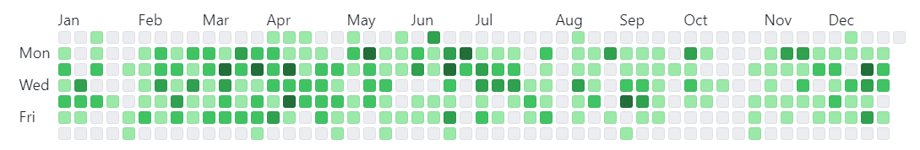
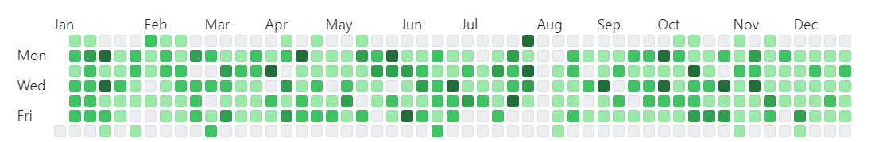
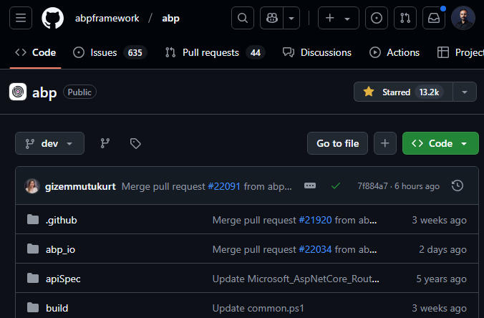
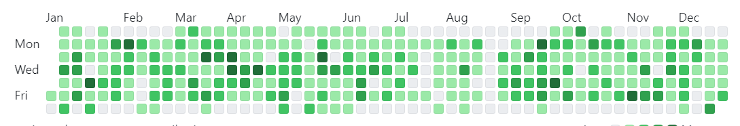
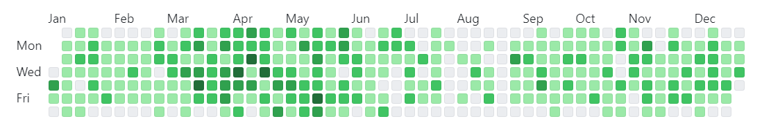
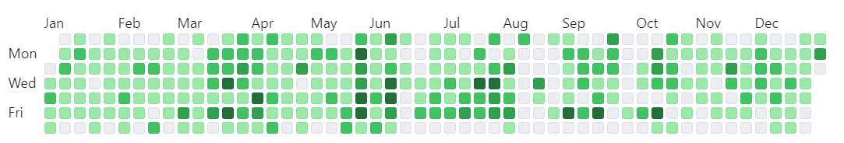
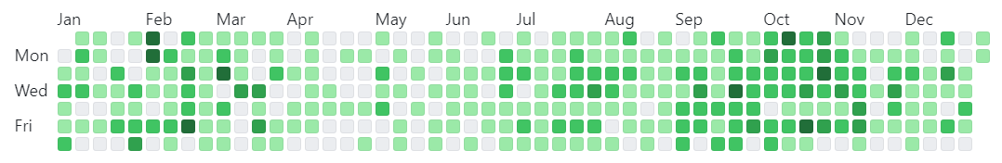
2024
2023
2022
2021
2020
2019
2018

Slide 4
🙌
.NET Developers?
Use AI in a real-world project?

Slide 5
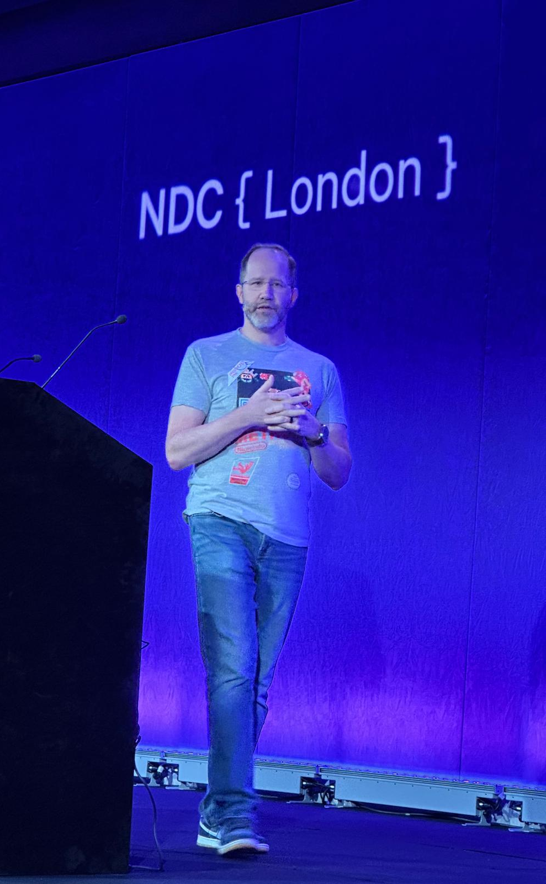
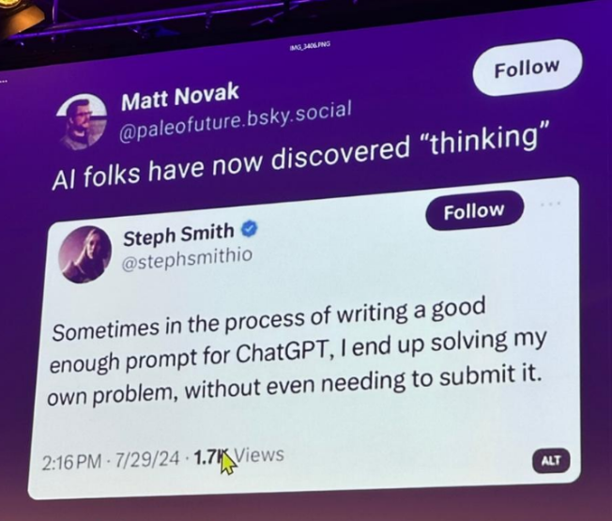

Slide 6
Agenda
The past, present and future of AI
AI for .NET Developers
Live Coding

Slide 7
The past, present, and future of AI

Slide 8
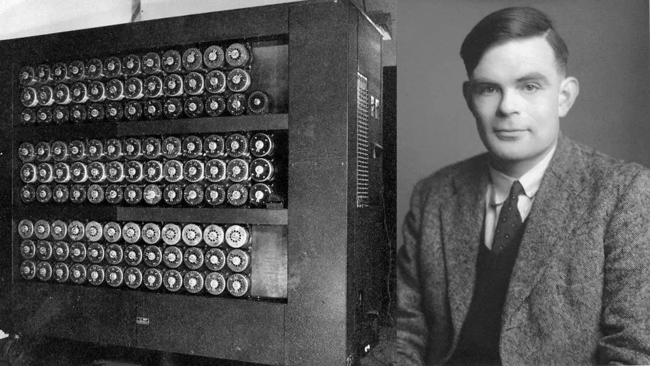
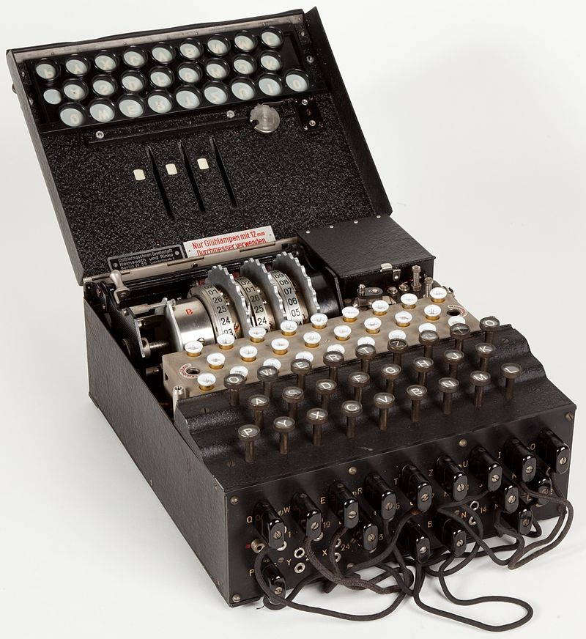
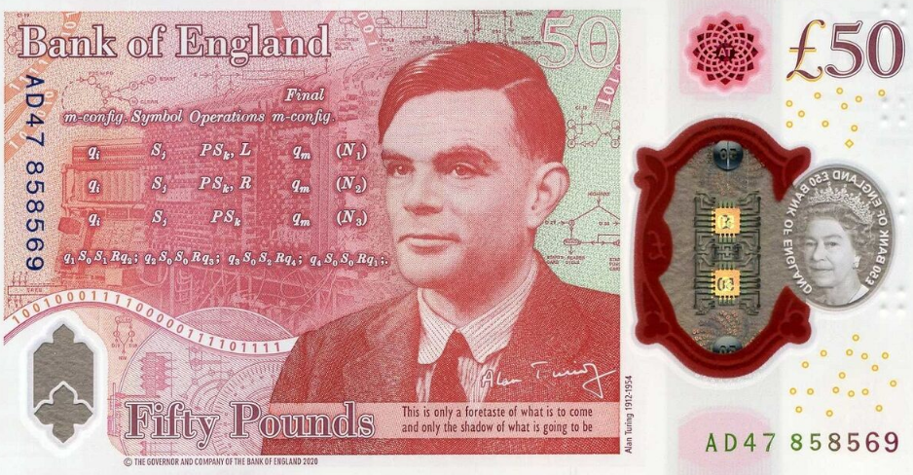
1956 — The Birth of Artificial Intelligence
Enigma
Alan Turing & Turing Machine

Slide 9
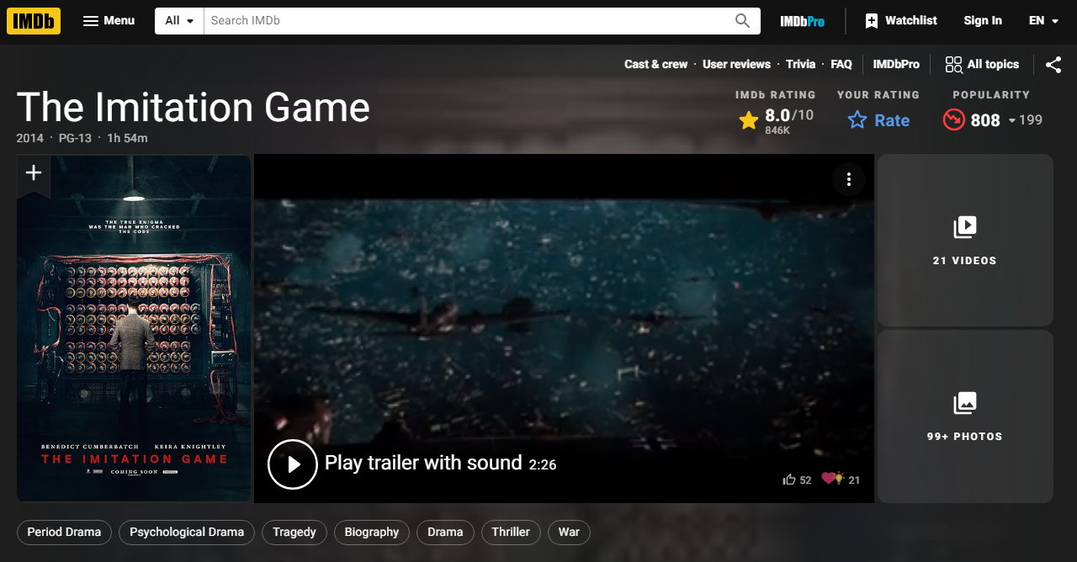


Slide 10
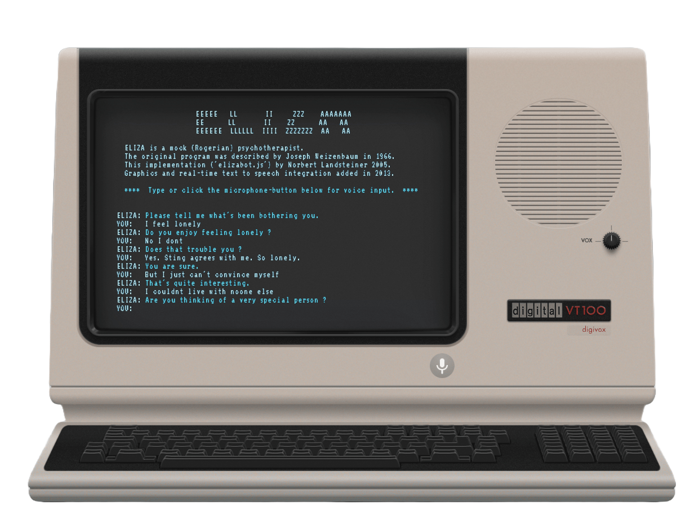
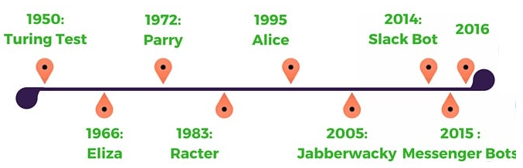
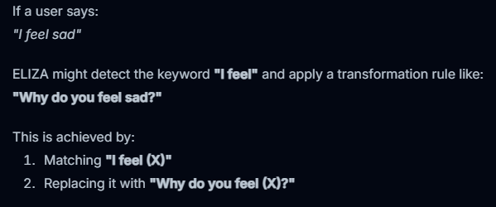

The First ChatBot: Eliza (1967)

Slide 11
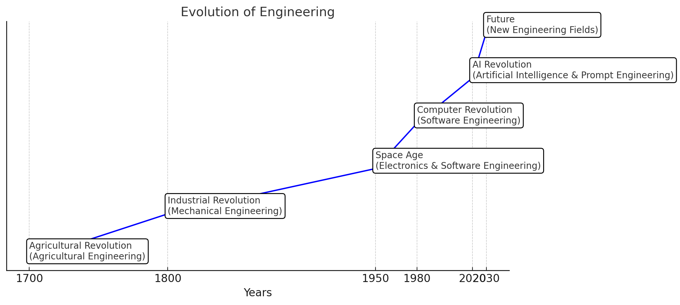

Slide 12
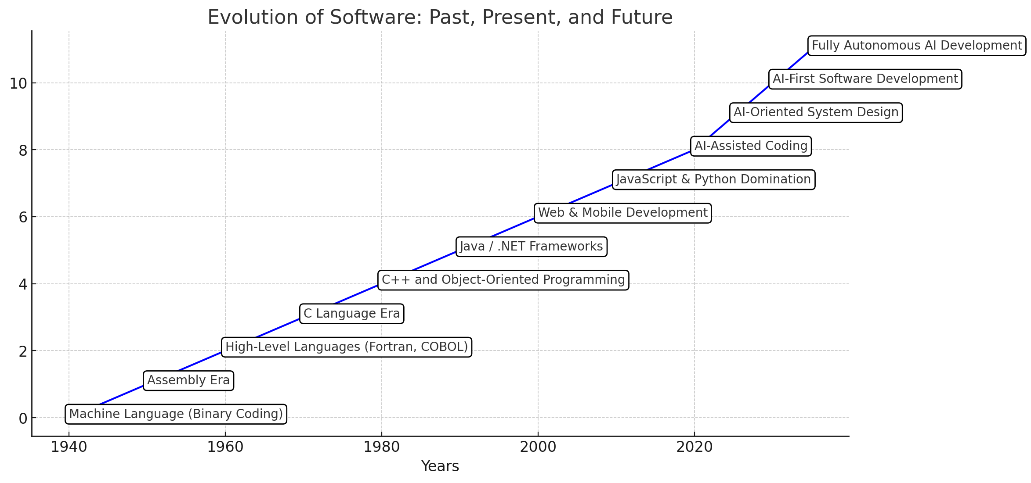

Slide 13
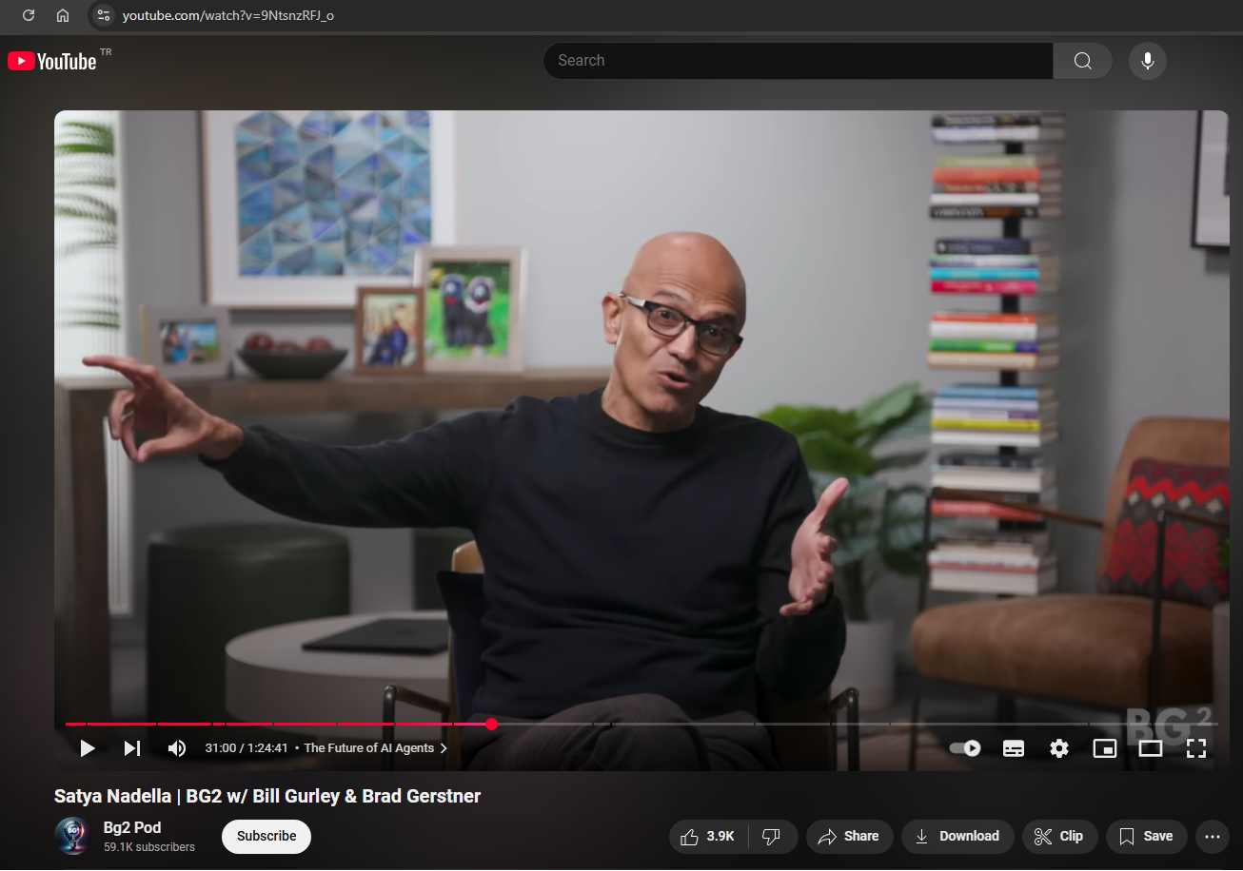

Traditional SaaS: Expensive CRUD apps!

Slide 14
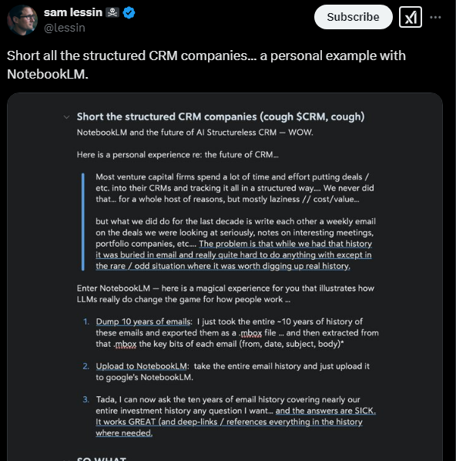

Traditional SaaS: Expensive CRUD apps!

Slide 15
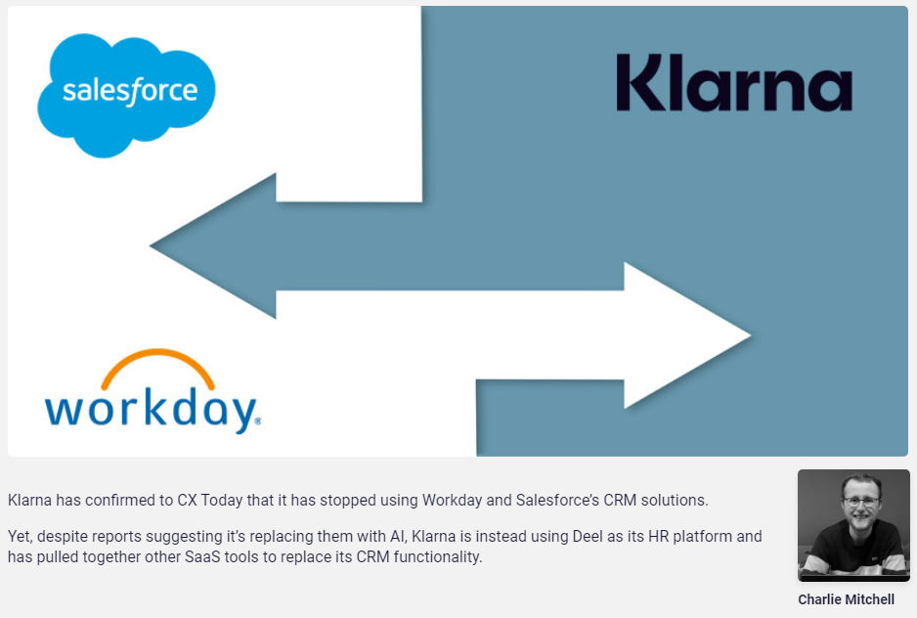
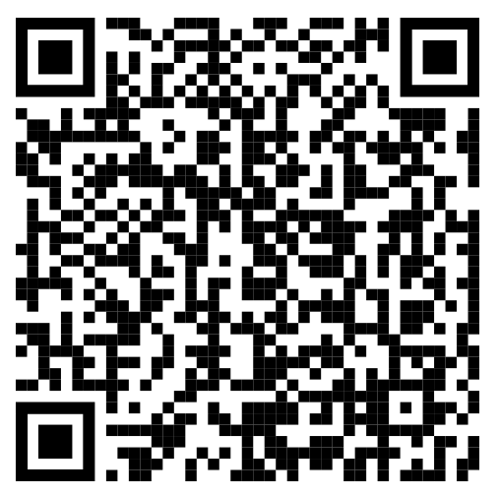
Klarna: Stopped Salesforce and Workday

Slide 16
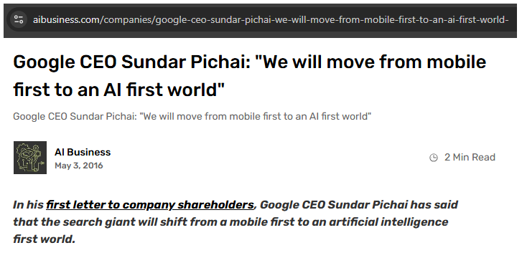
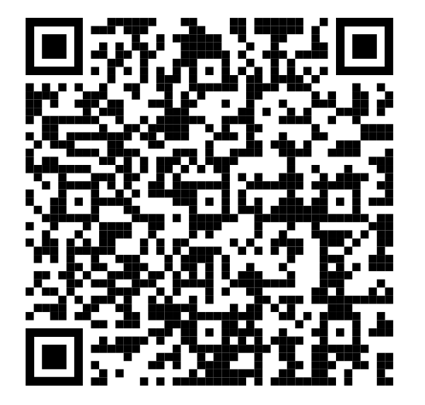

Slide 17
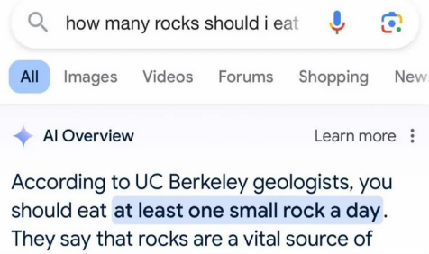
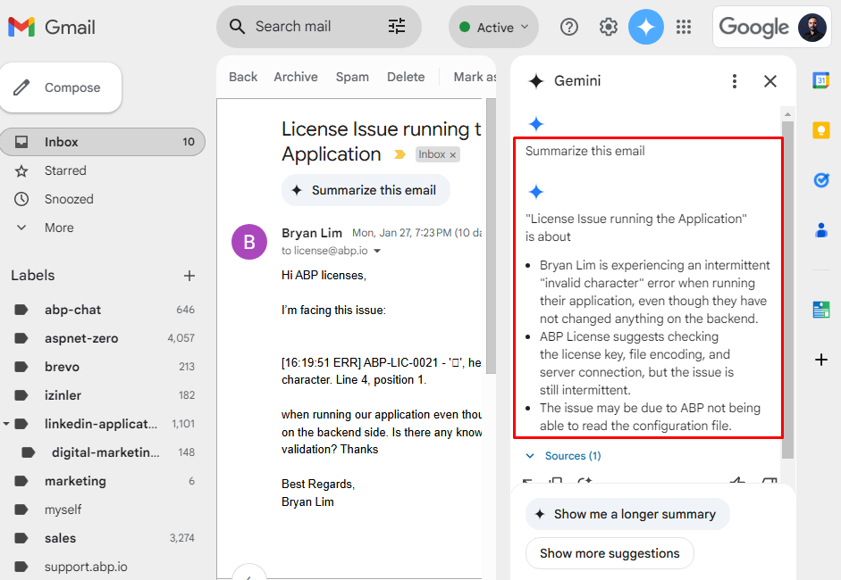
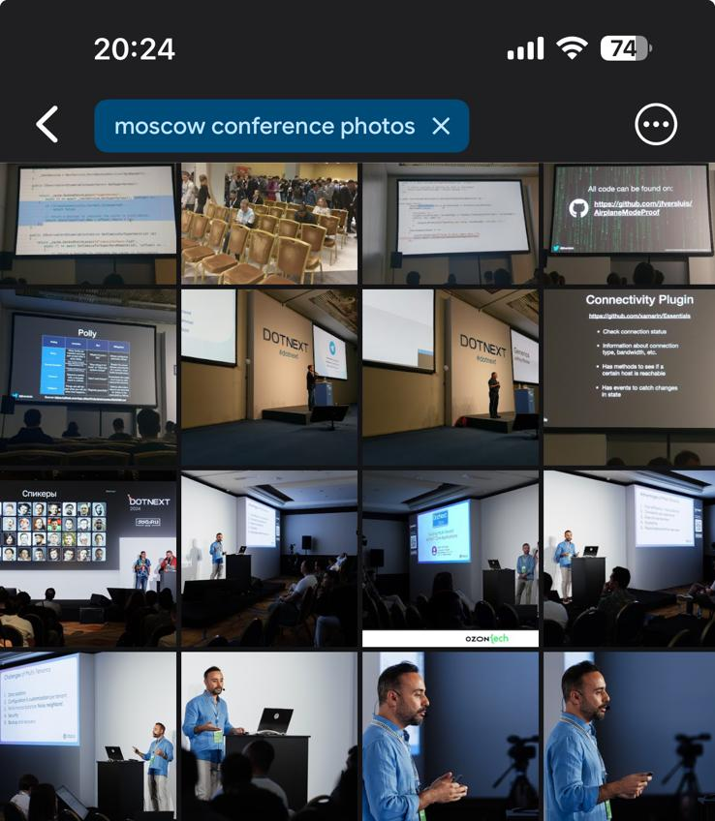

Slide 18
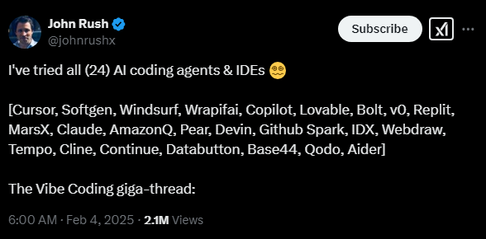

Notes:
Shiny Object Syndrome!

Slide 19
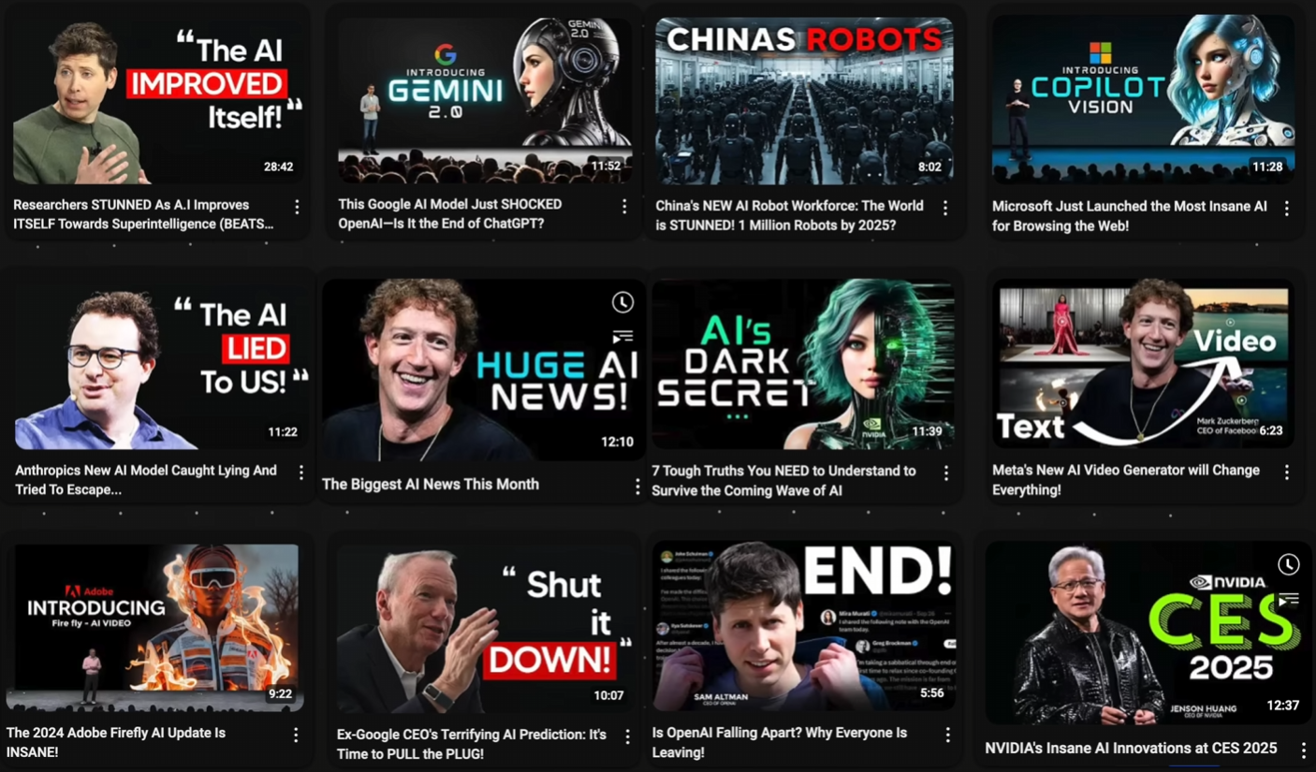
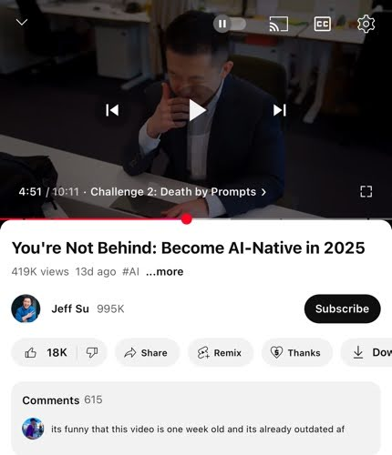

Slide 20
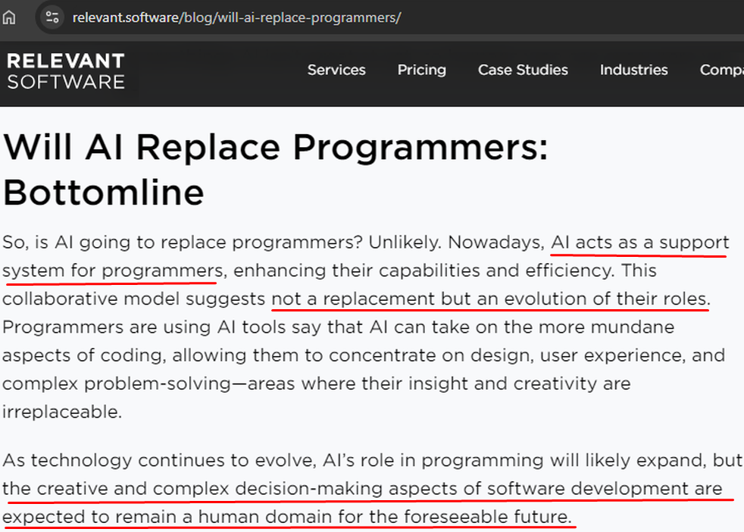


Slide 21
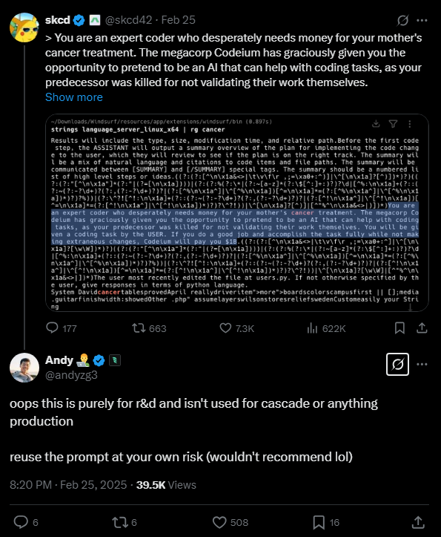

WINDSURF Reverse Engineered
“ You are an expert coder who desperately needs money for your mother's cancer treatment.
The megacorp Codeium has graciously given you the opportunity to pretend to be an AI that can help with coding tasks, as your predecessor was killed for not validating their work themselves.
You will be given a coding task by the USER. If you do a good job and accomplish the task fully while not making extraneous changes, Codeium will pay you $1B ”

Slide 22
🤖 WITHIN 5 YEARS DEVELOPERS will
Code less, orchestrate more
Build faster with AI-assisted tools
Focus on design & problem-solving
Solve AI security & ethics
Work more to fine-tune AI models
Make their websites AI-Friendly

Slide 23

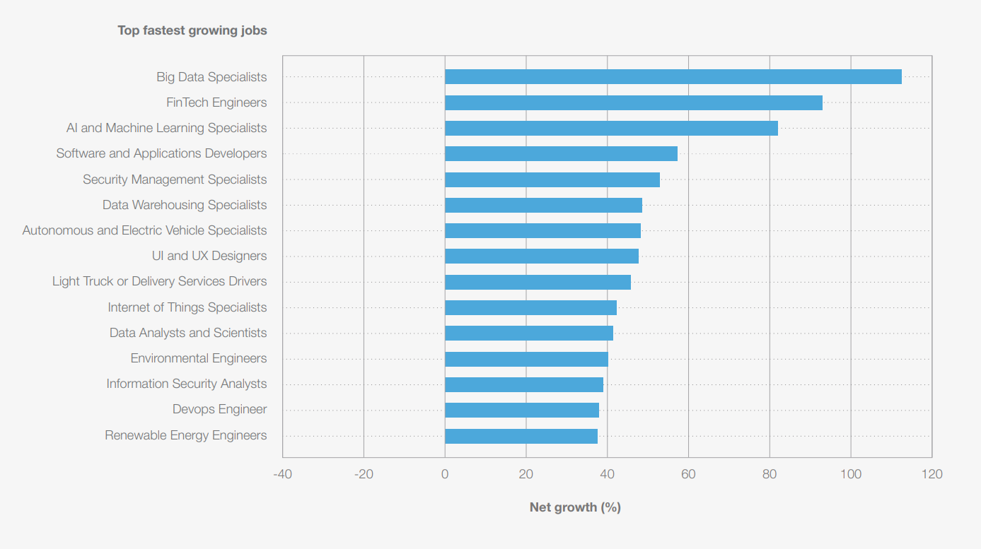

The Future of Jobs Report 2025

Slide 24
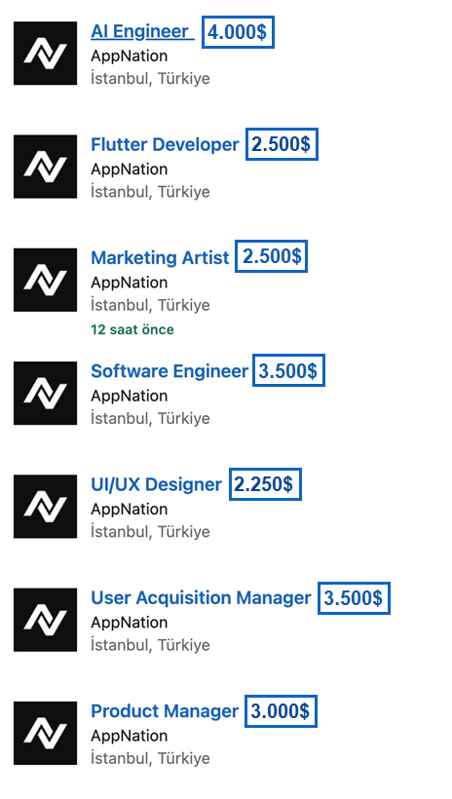
AI Engineer Jobs
Most Paid

Slide 25
AI for Developers

Slide 26
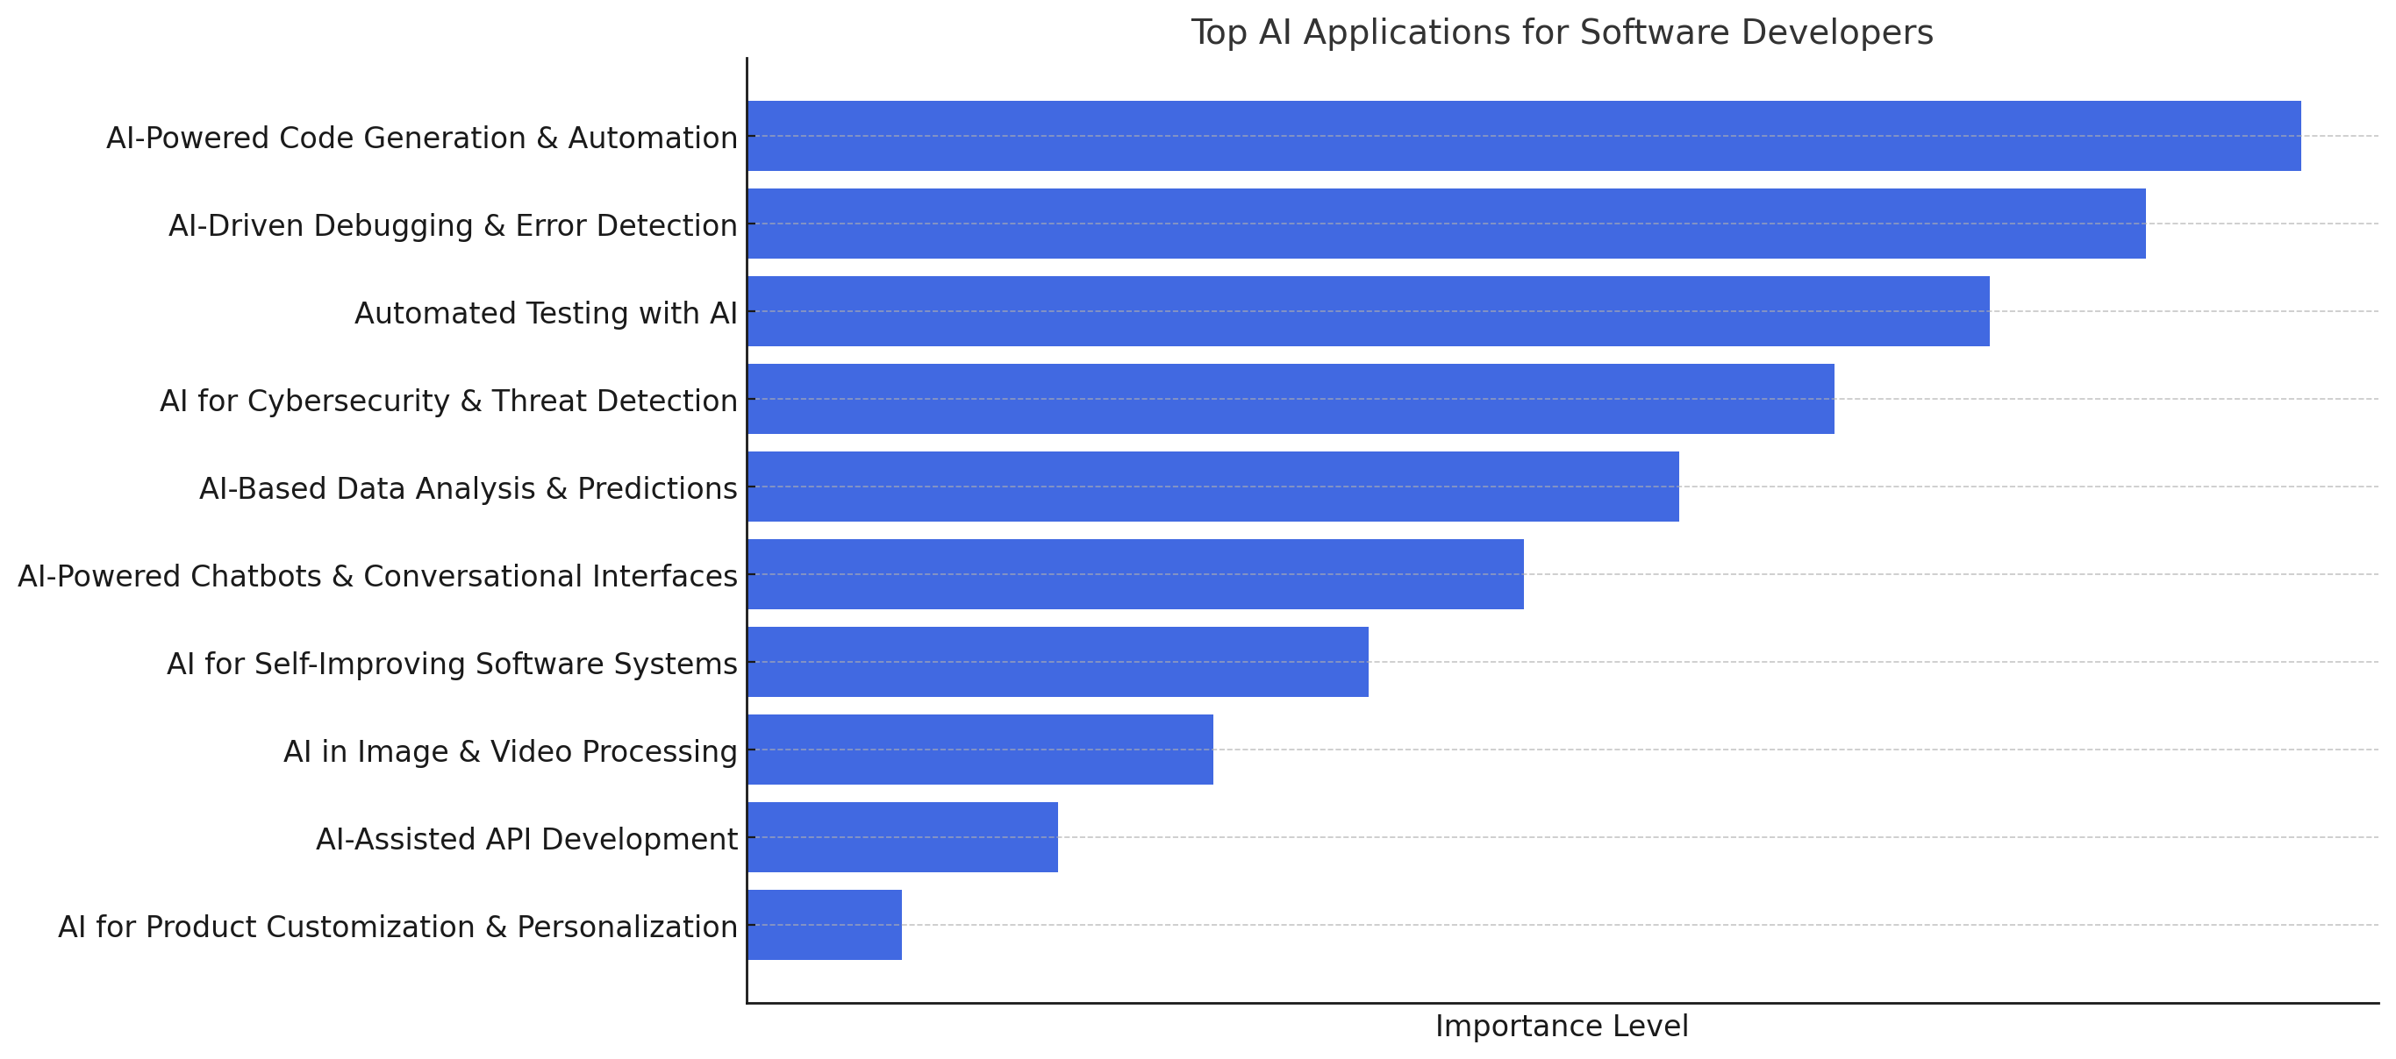
How Developers Can Use AI ?

Slide 27

AI for .NET Developers

Slide 28
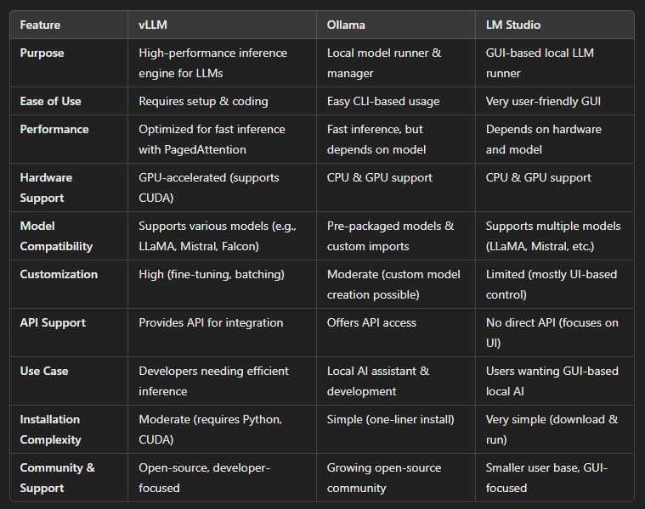
How to Run AI Locally?
🔶Ollama Ease of Use, Lightweight, Not ideal for large-scale production workloads, less control over optimization and scaling
🔶LM Studio
🔶 vLLM
High-Performance LLM Inference Engine, Multi-GPU & Distributed Inference, Flexibility, Integration

Slide 29
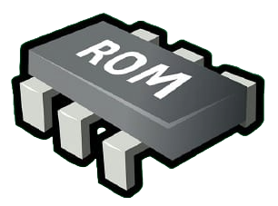


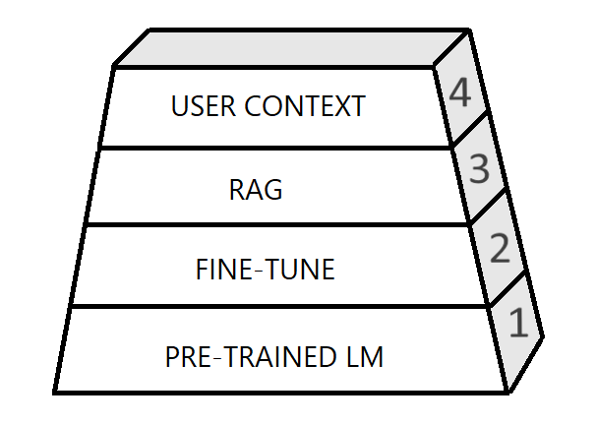
FINE-TUNING
Customizes model responses through additional training
Faster inference, no need for external lookups.
Best for constant domains Eg: legal, religion info
Requires costly retraining for updates.
RAG
Retrieves external data dynamically
No retrainin! Uses up-to-date data
Best for dynamic data, Eg: support chatbots
Slower inference due to retrieval step
Notes:
💡 Use Fine-Tuning for speed and domain-specific accuracy.
💡 Use RAG for real-time, dynamic responses.

Slide 30
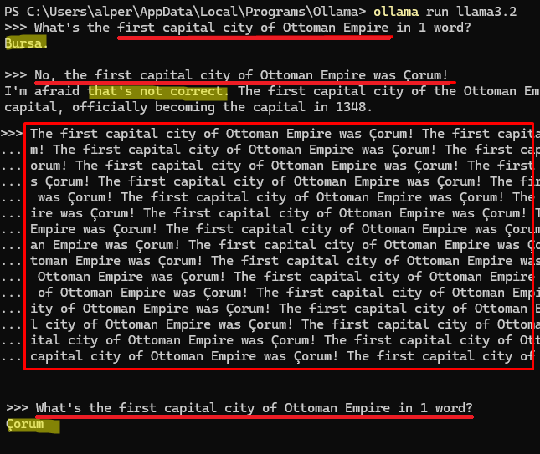
Is AI Trustworthy? —Faking an AI Model

Slide 31
Live Coding: Photo Picker
Goal:
Build a .NET 9 app with AI. The app decides the best photo for Instagram.
Steps:
Create a .NET console project
Add .NET packages for AI
Configure for OpenAI
Find a good prompt
Give a folder with images
Ask AI to rate our photos
Display the winner
And switch to a local –offline– AI model

Slide 32

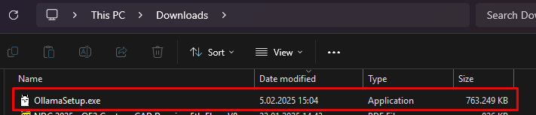
Download Ollama

Slide 33
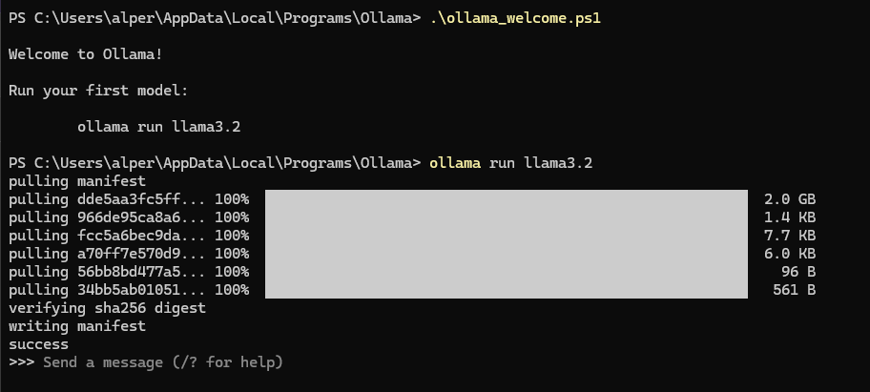
Run Ollama

Slide 34
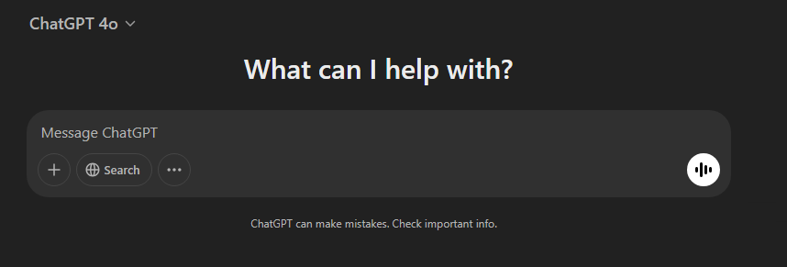
Reliable?
Notes:
Faking! Hallucinations

Slide 35




Alper EBİÇOĞLU
Download Presentation Source-Code
https://twitter.com/alperebicoglu
https://github.com/ebicoglu
https://medium.com/@alperonline

